Slide 1
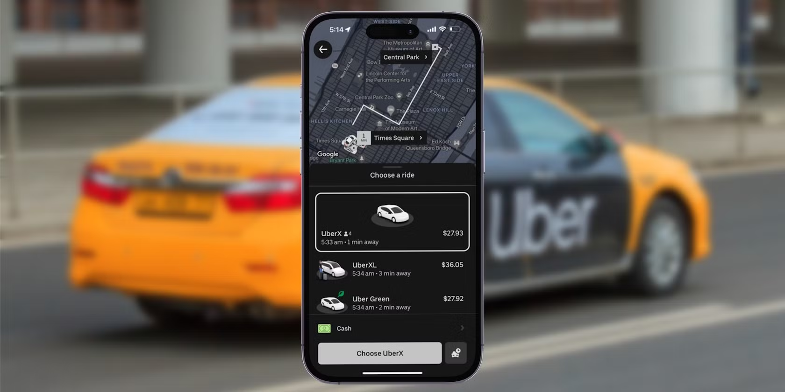
Uber Data Analysis

Slide 2

DATA OVERVIEW
Dataset Size: 354 rows × 4 columns
Time Period: January–February (daily records)
Source Context: Uber dispatching activity in New York (sample data
Features:
dispatching_base_number – Unique ID of the Uber base/office responsible for dispatching trips.
date – Date of the recorded activity.
active_vehicles – Number of active vehicles available on that day.
trips – Number of trips completed on that day.

Slide 3
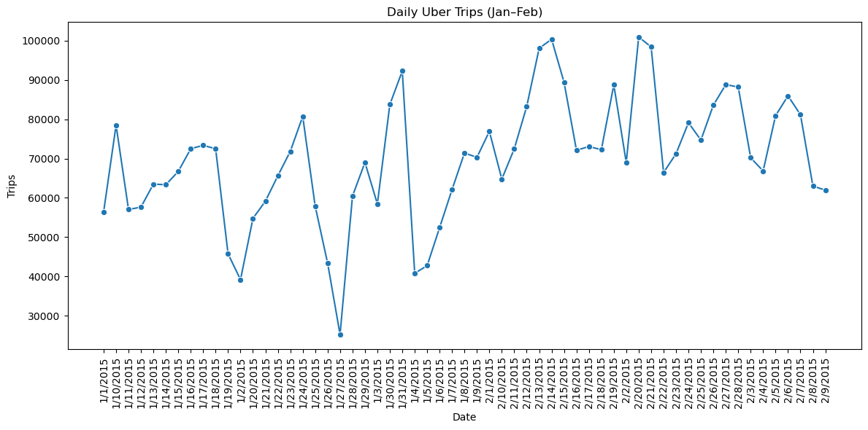
Daily Uber Trips
Daily trips grew from lows of 25k–40k in early January to peaks of over 100k by mid–late February.

Slide 4
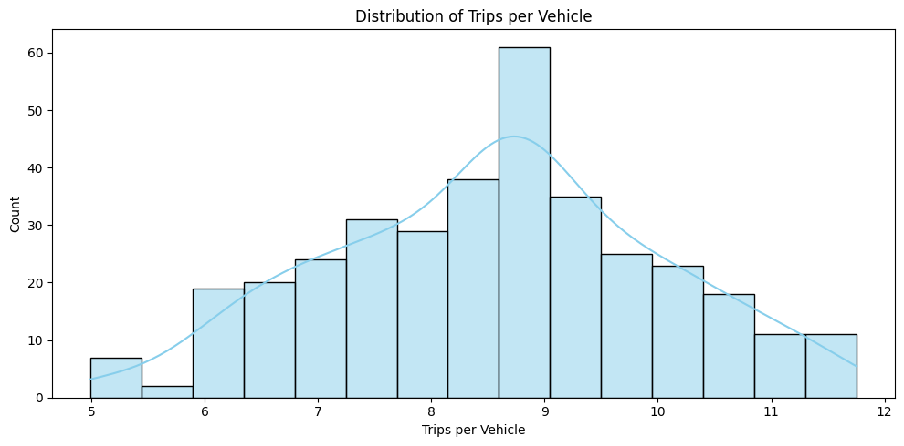
Distribution of Trips per Vehicle
Most vehicles completed around 8–9 trips per day, with fewer vehicles making less than 6 or more than 11 trips.

Slide 5
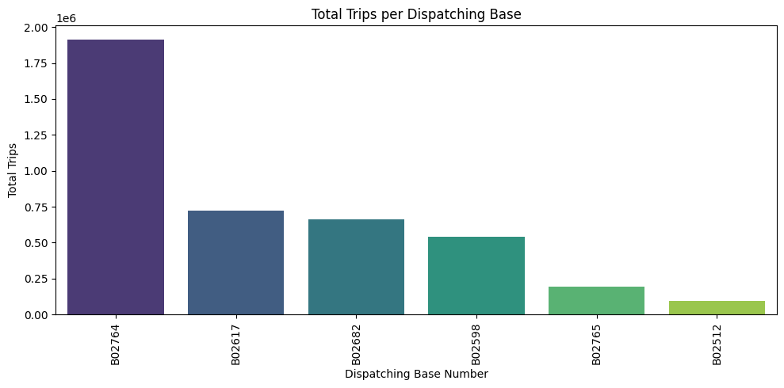
Total Trips per Dispatching Base
The dispatching base B02764 had the highest number of trips, significantly more than any other base.

Slide 6
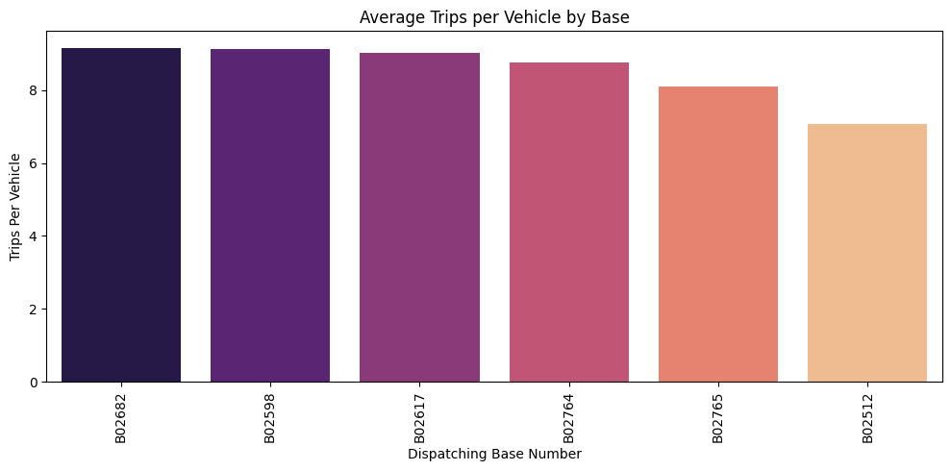
Average Trips per Vehicles by Base
Dispatching bases B02682 and B02598 have the highest average trips per vehicle, indicating greater vehicle utilization compared to the other bases.

Slide 7
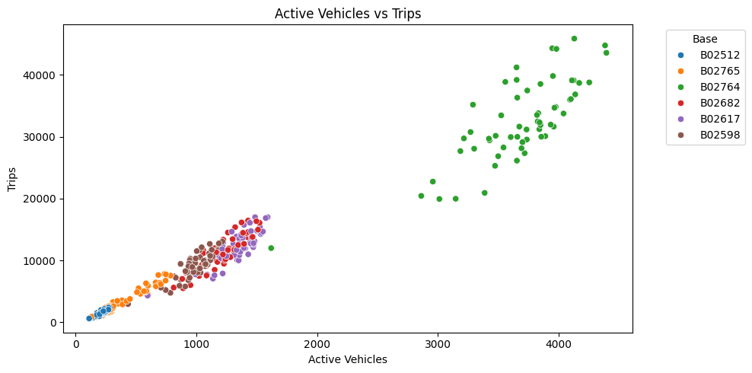
Active Vehicles v/s Trips
Base B02764 has a significantly larger number of active vehicles and trips compared to all other bases, which are clustered together with a lower count of both.

Slide 8
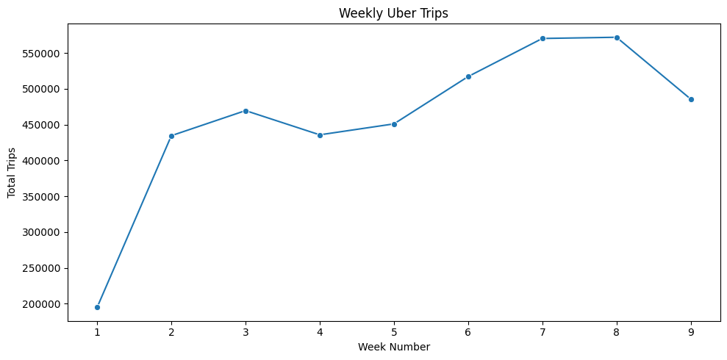
Weekly Trips
Uber trips rose sharply in early January, peaked in late February (weeks 7–8), then declined in week 9
Trips increased from ~200K in week 1 to over 570K by week 8, before dropping in week 9.

Slide 9
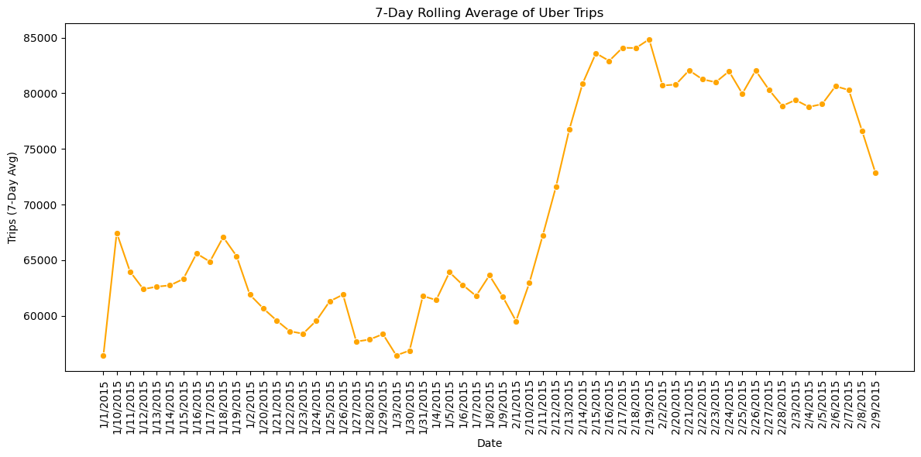
7-Day Rolling Average of Uber Trips
Mid-February spike: Trips surged, with the 7-day average jumping from ~65K to 85K+.
Late-February plateau: Numbers stabilized at a higher level, staying above early-February figures.
Possible causes: Event, marketing push, or service expansion.

Slide 10
Business Insights – February Trip Surge
Record Demand: Daily trips peaked at 100K+ (mid-Feb), up from ~65K early Feb.
High Utilization: Average 8–9 trips per vehicle per day indicate strong fleet efficiency.
Base Dominance: Top 2 bases (B02764,B02617) cover ~80% of all trip these are the key hubs to prioritize for driver supply and marketing.
Late-Feb Stability: Trips stabilized at a new high of ~80K–90K/day, sustaining post-spike demand.
Growth Strategy: Focus promotions on top bases and ensure fleet capacity to handle >100K trips/day during peaks

Slide 11
Presented by Ayesha Nadaf
Thank You!

